Slide 1
Introduction to Statistics and Choosing the Right Test
Vanessa LoBue
Jamil Bhanji
with a little help from Andy Field

Slide 2
Aims
Know the basic terms that we will use throughout the semester
Introduction to how to choose a statistical test

Slide 3
The Research Process
Notes:
Find something that needs explaining
Observe the real world
What do we do and why do we need statistics to help us?

Slide 4
Why do we use statistics?
Present data in ways that are easier to understand
Make inferences about a population based on the data we collect
Test our hypotheses

Slide 5
Why are people afraid of statistics?
Fear of failure
Doubts about worth of statistics
Test and class anxiety
Fear of asking for help
Fear of statistics instructor
Onwuegbuzie (2010)
Notes:
Fear of statistics is related to

Slide 6
A well-kept secret in academia…
Most faculty don’t always know exactly what statistical test they should use
We also need to reference books and charts to figure it out
That’s what books, charts, and people who know more than you are there for

Slide 7
The Research Process
Notes:
After we find something that needs explaining, we need a theory about it, and hypotheses to explain it.

Slide 8
Generating and Testing Theories
Theories
An hypothesized general principle or set of principles that explain known findings about a topic and from which new hypotheses can be generated
Research Question
A question that comes from a theory (non-directional)
Hypothesis
A directional prediction from a theory
Notes:
Example of hypothesis: E.g. the number of people turning up for a reality TV audition that have narcissistic personality disorder will be higher than the general level (1%) in the population.

Slide 9
Grounding Hypotheses in Theories
Hypotheses have underlying rationale
Logical reasoning behind the direction of the hypotheses (theoretical rationale – explanation)
Theoretical rationale based on:
1. Past research
2. Existing theory
3. Logical reasoning
Notes:
Hypotheses have an underlying rationale:

Slide 10
Generating and Testing Theories
Theories Observation
Observations are never theory-free
Notes:
when scientists observe or interpret data, they do so through the lens of their existing beliefs, theories, concepts, or assumptions
Think of Galileo’s observations of the stars and the same observations from the earth-centered theory
Now think of how you would observe (measure) intelligence

Slide 11
Good Theories
Guide research
Explain facts
Are testable (falsifiable)
Predict
Are useful
Notes:
What is a theory & what's it supposed to do?
WHAT MAKES A GOOD THEORY????
1. Guide research
tells you what facts to look at & what to ignore
how to gather evidence questions/answers
2. Explain relevant facts
not just for one observation but across similar cases
3. Be testable with experiments
some way to prove your theory wrong in principle
Falsification
The act of disproving a theory or hypothesis.
4. Predict what's going to happen next
explain ahead of time
5. Be useful for real life
tell parents, teachers, doctors, govt ways to behave w/children*****

Slide 12
The Research Process
Notes:
Now we can talk about the variables and how we measure them.

Slide 13
Types of Data Analysis
Quantitative Methods
Testing theories using numbers
Qualitative Methods
Testing theories using language
Magazine articles/Interviews
Conversations
Newspapers
Media broadcasts
Notes:
We focus mostly on quant here

Slide 14
Identifying Your Variables
Independent Variable
The proposed cause
A predictor variable
A manipulated variable (in experiments)
Dependent Variable
The proposed effect
An outcome variable
Measured not manipulated (in experiments)
Notes:
Hypothesis:
Coca-cola kills sperm.
IV :Coca-cola in the hypothesis above
DV: Sperm in the hypothesis above

Slide 15
Different Kinds of Variables
Categorical (entities are divided into distinct categories):
Binary variable: There are only two categories e.g. dead or alive
Nominal variable: There are more than two categories e.g. whether someone is an omnivore, vegetarian, vegan, or fruitarian
Ordinal variable: The same as a nominal variable but the categories have a logical order e.g. whether people got a fail, a pass, a merit or a distinction in their exam

Slide 16
Different Kinds of Variables
Continuous (entities get a distinct score):
Interval variable: Equal intervals on the variable represent equal differences in the property being measured e.g. the difference between 6 and 8 is equivalent to the difference between 13 and 15.
Ratio variable: The same as an interval variable, but the ratios of scores on the scale must also make sense e.g. a score of 16 on an anxiety scale means that the person is, in reality, twice as anxious as someone scoring 8. (there is a ”true zero”)

Slide 17
Measurement Error
Measurement error
The discrepancy between the actual value we’re trying to measure, and the number we use to represent that value
Example:
You (in reality) weigh 170 lbs.
You stand on your bathroom scale and it says 172 lbs
The measurement error is 2 lbs (right? How do we know it’s error?)

Slide 18
Validity
Whether an instrument measures what it set out to measure.
Content validity
Evidence that the content of a test corresponds to the full definition of the construct it was designed to cover
Ecological validity
Evidence that the results of a study, experiment or test can be applied, and allow inferences, to real-world conditions

Slide 19
Reliability
Reliability
The ability of the measure to produce the same results under the same conditions.
Test-Retest Reliability
The ability of a measure to produce consistent results when the same entities are tested at two different points in time.
Interrater Reliability
The ability of a measure to produce consistent results when the same entities are tested by two different raters.
Notes:
Consistency across time (test-retest)
Consistency across observers (interrater)
Consistency across measurement subcomponents/items (internal)

Slide 20
Methods of Data Collection
Between-group/Between-subject/independent
Different entities in experimental conditions
Repeated measures (within-subject)
The same entities take part in all experimental conditions.
Economical
Practice effects
Fatigue

Slide 21
Types of Variation
Systematic Variation
Differences in performance created by known factors (e.g., an experimental manipulation)
Unsystematic Variation
Differences in performance created by unknown factors
ability, IQ, Time of day, Measurement error etc.
Randomization (random assignment of conditions)
Minimizes unsystematic variation

Slide 22
Visualizing Data: Histograms
Frequency Distributions (aka Histograms)
A graph plotting values of observations on the horizontal axis, with a bar showing how many times each value occurred in the data set
The ‘Normal’ Distribution
Bell shaped
Symmetrical around the centre

Slide 23
The Normal Distribution
https://www.youtube.com/shorts/TwctT3Ncm1w
Notes:
The curve shows the idealized shape.

Slide 24
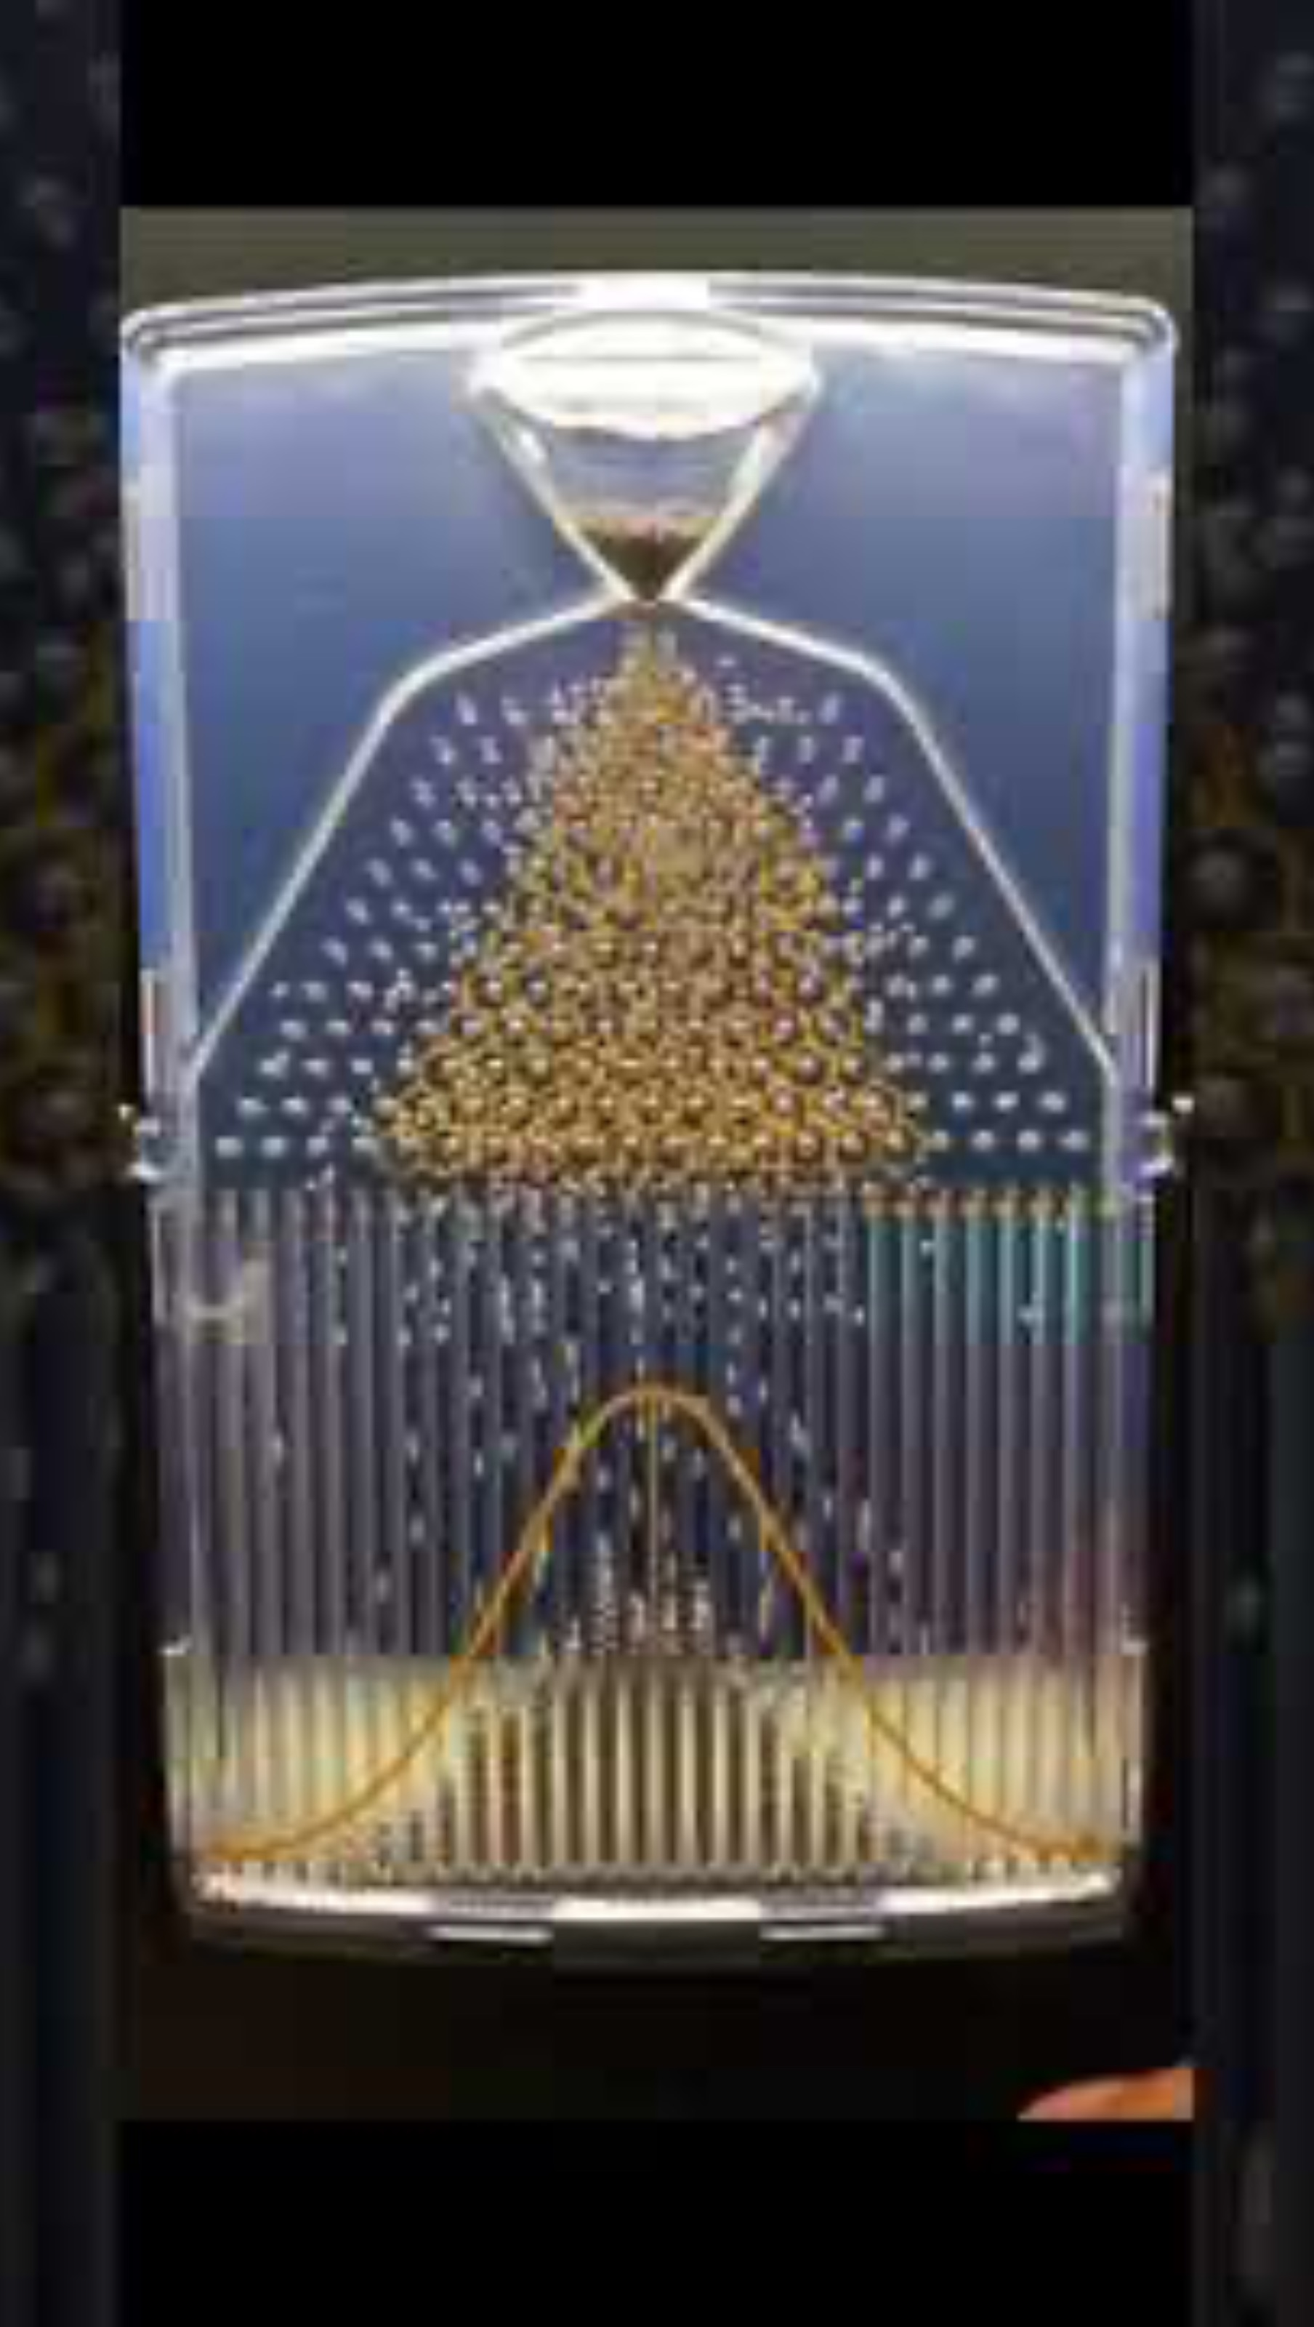
The Normal Distribution
https://www.youtube.com/shorts/TwctT3Ncm1w
Notes:
The curve shows the idealized shape.

Slide 25
The Normal Probability Distribution

Slide 26
Probability Density Function of a Normal Distribution

Slide 27
Z-Scores
Z-scores
Standardising a score with respect to the other scores in the group.
Expresses a score in terms of how many standard deviations it is away from the mean.
The distribution of z-scores has a mean of 0 and SD = 1.
Notes:
Score minus the mean, over the standard deviation

Slide 28
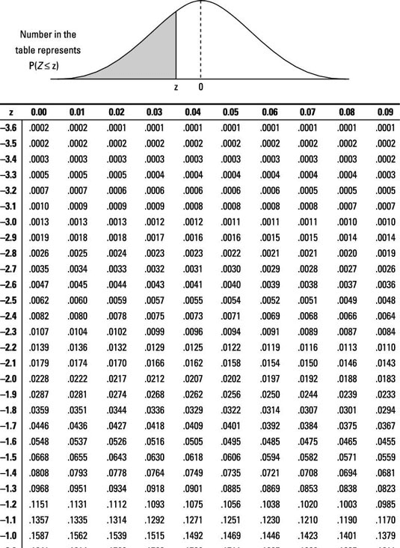
The Normal Distribution of Z-Scores
1.96 cuts off the top 2.5% of the distribution.
−1.96 cuts off the bottom 2.5% of the distribution.
As such, 95% of z-scores lie between −1.96 and 1.96.
99% of z-scores lie between −2.58 and 2.58,
99.9% of them lie between −3.29 and 3.29.

Slide 29
Properties of Frequency Distributions
Skew
The symmetry of the distribution.
Positive skew (scores bunched at low values with the tail pointing to high values).
Negative skew (scores bunched at high values with the tail pointing to low values).
Kurtosis
The ‘heaviness’ of the tails.
Leptokurtic = heavy tails.
Platykurtic = light tails.

Slide 30
Skew
Notes:
Where the tail is pointing
Skew
The symmetry of the distribution.
Positive skew (scores bunched at low values with the tail pointing to high values).
Negative skew (scores bunched at high values with the tail pointing to low values).

Slide 31
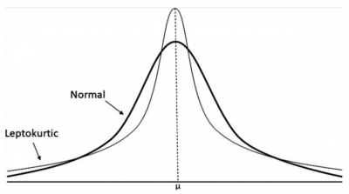
Kurtosis
Notes:
Kurtosis
The ‘heaviness’ of the tails.
Leptokurtic = heavy tails.
Platykurtic = light tails.

Slide 32
Central Tendency: Mode
Mode
The most frequent score
Bimodal
Having two modes
Multimodal
Having several modes

Slide 33
Bimodal and Multimodal Distributions

Slide 34
Central Tendency: Median
The Median is the middle score when scores are ordered:

Slide 35
Central Tendency: Mean
The Mean is the sum of scores divided by the number of scores:

Slide 36
The Dispersion: Interquartile Range
Quartiles
The three values that split the sorted data into four equal parts.
Second Quartile = median.
Lower quartile = median of lower half of the data
Upper quartile = median of upper half of the data
Notes:
The Range
The smallest score subtracted from the largest

Slide 37
Deviance
We can calculate the spread of scores by looking at how different each score is from the center of a distribution, e.g., the mean:
Notes:
Deviance is the individual score minus the mean
Total deviance, you add them. And you get zero. Not very useful, but …

Slide 38
Sum of Squared Errors, SS
Indicator of the total dispersion, or total deviance of scores from the mean:
Its size is dependent on the number of scores in the data.
More useful to work with the average dispersion, known as the variance:
Notes:
But some of those scores will be negative, so we have to square each and then add them – sum of squares
Variance is the sum of squares over your N minus one, or number of scores minus one.

Slide 39
Standard Deviation
The variance gives us a measure in units squared.
This problem is solved by taking the square root of the variance, which is known as the standard deviation:
Notes:
When we take the square root of the variance, that is the SD. Standard deviation is not necessarily sensitive to your sample size.

Slide 40
Same Mean, Different SD

Slide 41
Important things to remember…
The sum of squares, variance, and standard deviation represent the same idea:
The ‘Fit’ of the mean to the data
How well the mean represents the observed data
Error
The variability in the data

Slide 42
Choosing a Statistical Test

Slide 43
1. What kind of question are you asking?
Description of one group
Comparison of one group to a hypothetical value
Comparison of two groups
Comparison of three or more groups
Measure the association between variables
Make a prediction

Slide 44
2. What kind of variables do you have?
Nominal data—categories (e.g., male, female)
Ordinal data—logically ordered categories (e.g., how happy are you on a scale of 1 to 4?)
Interval Data—meaningful order, equal intervals, but no natural zero (e.g., temperature, IQ)
Ratio Data—meaningful order, equal intervals, nautral zero (e.g., height, weight, length)

Slide 45
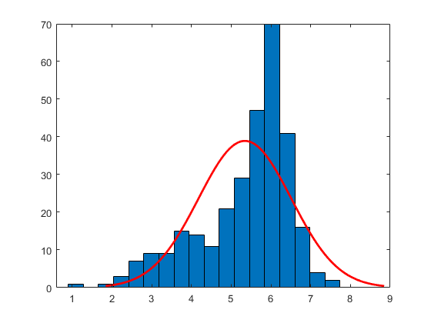
3. Is your data normally distributed?
Notes:
As we go forward you will see that we actually care about the normality of the errors

Slide 46
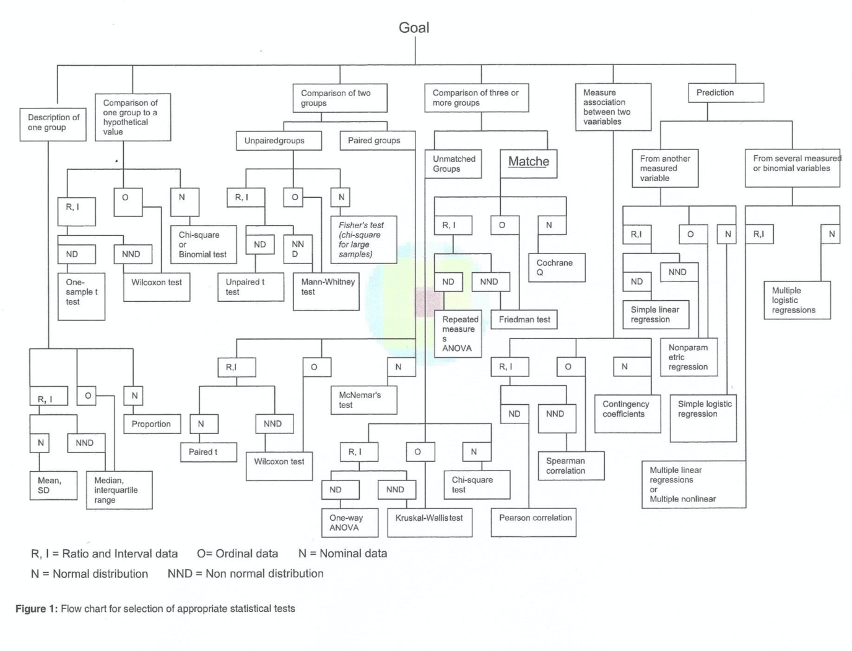
Basics on selecting a statistical test
Jaykaren (2010)

Slide 47
Basics on selecting a statistical test
Jaykaren (2010)

Slide 48
Basics on selecting a statistical test
Jaykaren (2010)

Slide 49
Basics on selecting a statistical test
Jaykaren (2010)

Slide 50
Basics on selecting a statistical test
Jaykaren (2010)

Slide 51
Basics on selecting a statistical test
Jaykaren (2010)
Notes:
Within or between

Slide 52
Basics on selecting a statistical test
Jaykaren (2010)
Notes:
Within or between

Slide 53
Basics on selecting a statistical test
Jaykaren (2010)
Notes:
Within or between

Slide 54
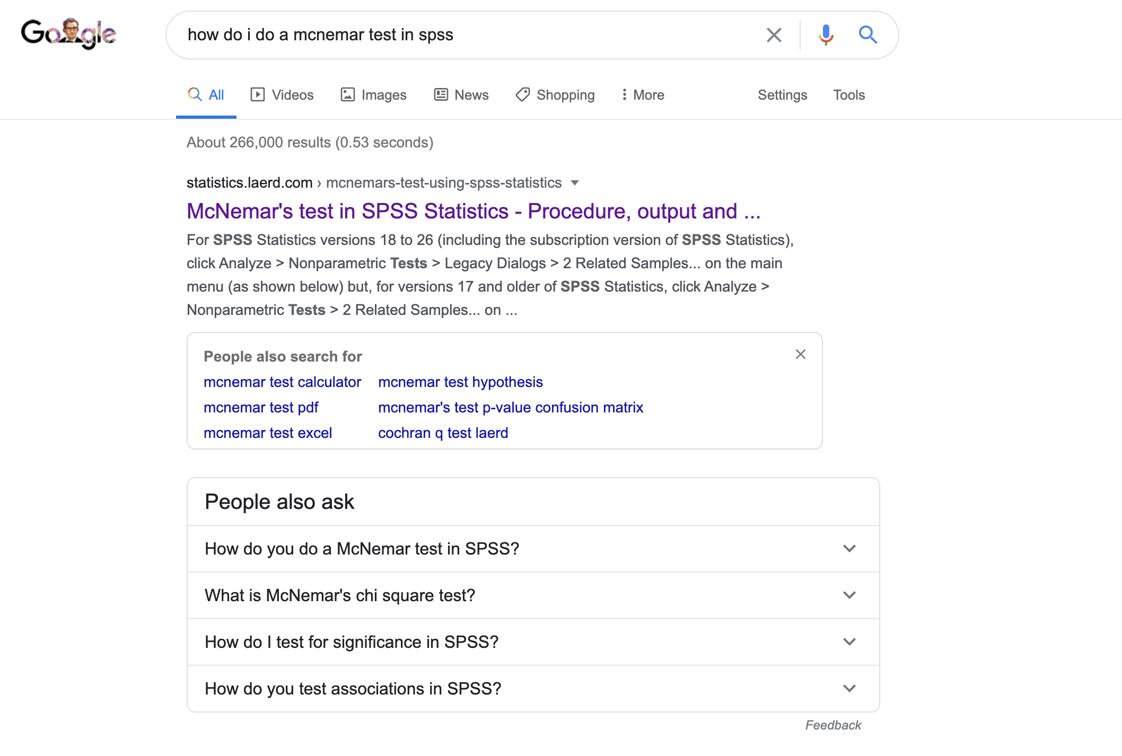
After you’ve selected a test…

Slide 55
Amount of Experimental Control
None
A lot
Notes:
RESEARCH METHODS: AMOUNT OF EXPERIMENTAL CONTROL
Can vary on a continuum
Range from non (naturalistic obs) to lots (experiments)

Slide 56
Amount of Experimental Control
None
A lot
Naturalistic & Structured Observations
Notes:
Naturalistic
Least amt of cntrl
Rich description of events (ex: what happened w/subway riders, beanbag chair)
Typ, E doesn’t interact w/ Ss so not to chg their beh
Some of most impt work in dev psych came from nat studies
Piaget, most famous dev psychol
From watching his 3 kids Jacqueline, Lucienne, & Laurent
Wrote Origins of intelligence, influential volume on ideas of chi dev
Darwin & Doddy Darwin

Slide 57
Amount of Experimental Control
None
A lot
Naturalistic & Structured Observations
Specimen record
Notes:
Specimen record
Write down everything that happened

Slide 58
Amount of Experimental Control
None
A lot
Naturalistic & Structured Observations
Specimen record
Event sampling
Notes:
Event sampling
Watch for particular instance of events
Subway video: watch for every instance of aggression
Beanbag video: watch for every instance of imitation

Slide 59
Amount of Experimental Control
None
A lot
Naturalistic & Structured Observations
Specimen record
Event sampling
Time sampling
Notes:
Time sampling
Check in @ part time pnts (e.g., every 5 min)
Can be used as specimen record or event sampling
Beanbag video: every 5 min, imitation beh or all beh
EAR

Slide 60
Amount of Experimental Control
None
A lot
Correlation
Notes:
Correlational
Ask abt relationship b/t 2 factors
WITHOUT being able to draw conclusions

Slide 61
Amount of Experimental Control
None
A lot
Correlation
Notes:
Can tell U relationships that have
No rel (activ has no rel w/ utter)
Positive rel (activ increase as utter increase)
Negative rel (active decrease as utter increase)

Slide 62
Amount of Experimental Control
None
A lot
Correlation
Can’t infer causation
What do we need to infer causation?
Association (correlation)
Temporal precedence (directionality)
Internal Validity (no 3rd variable)
Notes:
Repeat,
Can show relationships
Cannot infer causality
Look @ activity level and # utter (words) in chi
Doesn’t show you activ causes more talking or vice versa

Slide 63
Amount of Experimental Control
None
A lot
Correlation
Can’t infer causation
directionality and 3rd variable problem
Notes:
B/c can’t infer causality, 3rd variable prob
Don’t know if rel b/t 2 factors driven by outside variable
Maybe ht & wt correl b/c outside factor: increased intake of calories
Crimes x ice cream
Heat

Slide 64
Amount of Experimental Control
None
A lot
Experimental
Notes:
Experimental
Most amnt of cntrl
Usually done in lab
Can infer cause b/c can manipulate what causes change

Slide 65
Amount of Experimental Control
None
A lot
Experimental
Can infer cause: IVs, DVs
Notes:
Have experimental IV & DV
IV = experimental manipulated factor
DV = something that changes as a result of IV
Study effects of watching violence on TV on chi aggression
IV = amnt of violence on TV
DV = # of aggression acts
Can manip amnt of violence chi see & infer chi who saw more violence acted more agressively
Can infer seeing violence CAUSED agression
What if you didn’t manipulate any variables? What if you just observed children in their natural environments and found that children who tended to watch more tv tended to be more violent?
Have random assignment
Chi randomly assigned to groups

Slide 66
Amount of Experimental Control
None
A lot
Experimental
Can infer cause: IVs, DVs
Random assignment ⬇ bias
Notes:
Have random assignment
Chi randomly assigned to groups
1st chi group who see no violence, 2nd chi group who see some violence, 3rd chil group who see lots of violence
gets rid of biases

Slide 67
Amount of Experimental Control
None
A lot
Self report
Notes:
Self-Report method
Little more cntrl than naturalistic observations, but could also be used in experiments
Ask Q in some way & analyze answers reported by P

Slide 68
Amount of Experimental Control
None
A lot
Self report
Interview
Notes:
Interview
Structured so rigid (E must ask certain set of Qs)
or Flexible (E can change next Q to depend on what S said)
E.g., Motor milestones

Slide 69
Amount of Experimental Control
None
A lot
Self report
Interview
Questionnaire
Notes:
Questionnaires
Rigid structure
All Ss read & answer same set of Qs
Open-ended questionnaires are more naturalistic
“What do you remember about the morning of 9/11?”

Slide 70
Amount of Experimental Control
None
A lot
Self report
Interview
Questionnaire
Explanation
Notes:
Explanations
Popular for testing chi in 3-12 yr range
Ask chi to explain something/their answers
Some tasks dev by Piaget like this
Which glass has more water? Why?
These were experimental studies

Slide 71
Pros & Cons of Experimental Control
Design | Pro | Con
Naturalistic | Ecologically valid; can generalize | No control; no causality

Slide 72
Pros & Cons of Experimental Control
Design | Pro | Con
Naturalistic | Ecologically valid; can generalize | No control; no causality
Self-report | Quick & easy | Full of biases

Slide 73
Pros & Cons of Experimental Control
Design | Pro | Con
Naturalistic | Ecologically valid; can generalize | No control; no causality
Self-report | Quick & easy | Full of biases
Correlational | Can see relationship | No causality

Slide 74
Pros & Cons of Experimental Control
Design | Pro | Con
Naturalistic | Ecologically valid; can generalize | No control; no causality
Self-report | Quick & easy | Full of biases
Correlational | Can see relationship | No causality
Experimental | Lots of control; causal mechs | Ecologically invalid?

Slide 75
A note on causality…
“That ‘correlation does not imply causation’ is etched into the brains of all scientists…The ability to infer cause-effect is not even a statistical matter in the end. Rather, it is the design of one’s study, the data collection procedures one employs, and the theoretical plausibly that most directly influence whether a cause-effect claim can be made and with what degree of confidence…absent certain design features, numerous processes both systematic and haphazard can induce association between two variables…the greater number of such alternative explanations, the less comfortable we must be making cause-effect claims…”
Andrew Hayes
Introduction of Mediation, Moderation, and Conditional Process Analysis

Slide 76
A note on causality…
Third variable
A variable that causes the relation between two other variables
Confounding variable
A variable (that we may or may not have measured) other than the predictor variables that potentially affects an outcome variable
Ruling out other explanations
Control conditions: the cause is absent (experiment)
Controlling for possible third variables (partial correlation/multiple regression)
Notes:
e.g., the correlation between crime and ice cream consumption can be explained by heat

Slide 77
Number of Participants
Case study (1, 2, 3 kids)
Experimental (Little Albert)
Baby biography (Doddy Darwin)
Special children (Genie)
Existence proofs (Wertheimer’s daughter)
Larger samples
Notes:
Large samples
Large # of Ss needed if need statistics to tell U answer
More Ss, more statistical power
Especially in kids where lots of indiv variability
In our lab, ~ 16-24 kids per sample
When more var (looking time) use more kids
When less var (mobile), less kids

Slide 78
Timing of Observations
Cross-sectional (1 observation per S)
Same age, no groups (demonstration studies)
Different age groups (most popular design)
Same age, different ability groups (aka “age-matched controls” & “age-held constant design”)
Notes:
RESEARCH METHODS: TIMING OF OBSERVATIONS
Cross-sectional
Test chi only once
Usually, fairly lg groups of chi
All same age, no diff groups
Common for showing what chi can do @ certain age
Test 4-m-olds for evid of being able to count
Esp popular for nativists, who want to show inf have innate abil
Diff age groups
Star here b/c most popular design
Compare abil of chi @ diff ages
In daycare video, compare aggression of 18- & 24-m-olds
Supports discont researchers
All same age, diff groups according to ability
Aka “age-matched controls”
Elim age confounds
In daycare video, compare adjustment beh of 18-m-o whose mom drops them off vs. dad drops them off
Study 12-m-o’s social interaction: compare crawlers vs/ walkers
Can study nurture b/c allows study chi w/ diff abil or experiences

Slide 79
Timing of Observations
Longitudinal (≥ 2 observations per S)
Age
Ability
Pre/post intervention
Training - intentional intervention
Notes:
Longitudinal (tested 2+ times)
Test same Ps at least 2x
Diff ways to schedule sessions
Repeated measures design, where everyone gets the same manipulation multiple times.
By age
When reach certain age; b/t certain ages
Test kids @ 6, 12, 18, 24 mos to see if adjustment be chg
By ability
When abilities chg
When go f/ crawl to walk
Test lang dev @ preverbal, 1-word, 2-words, sent
E/ P @ diff age
Pre- and post- some manipulation
Test to get baseline meas (without any manip)
Manip
Test to get effects of intervention
Math abil; extra math classes; test to see if chged
Training – special type of pre/post
Intentional intervention
Johnny (not Jimmy) trained to var motor tasks over & over again
Microgenetic
Special type of long aimed @ watching chgs occur
Test same P at least 2 x
Dense obs times closely spaced so can watch as chgs happen
Test lang dev in 2-day intervals from preverbal to sent phase
Count daily # increase in vocab
B/c lang dev so rapid
Test dev of additional strat
Instead of testing when can’t add & when can add
Follow everyday to see if abrupt switch or plateau

Slide 80
Pros & Cons of Designs
Design | Pro | Con
Case study | Unique opportunity | Hard to generalize
Notes:
PROS & CONS OF RESEARCH DESIGNS
Case studies
Unique opp to ask Qs otherwise can’t ask
But, can’t generalize findings to broader pop base
Genie – M.R. b/c locked in closet? Locked in closet b/c M.R.?

Slide 81
Pros & Cons of Designs
Design | Pro | Con
Case study | Unique opportunity | Hard to generalize
Cross-sectional | Quick & easy | Can’t see development
Notes:
Cross-sectional
Quick & easy – chi tested only once
But, 1 session doesn’t allow to really see dev chgs
& can’t see how same ppl chage w/ experience
what chgs f/ 18 to 36 mos that makes lang better????
Try to fix this w/ age-matched control study

Slide 82
Pros & Cons of Designs
Design | Pro | Con
Case study | Unique opportunity | Hard to generalize
Cross-sectional | Quick & easy | Can’t see development
Longitudinal | Can see developmental changes | Expensive, repeated testing
Notes:
Longitudinal & mocrogenetic studies
Great b/c can watch dev chgs in same kids
But, lots of bad
Really expensive (time, $) to bring chi back several times
Changing E, coders
Changes in what’s popular in field
Some chi inevitable drop out
What are the effects of repeated testing?
Does it effect dev?
E.g., Carolyn Mervis studied lang dev
Like all dev psychols, Mervis excited to have baby
B/c study lang dev, wrote down/recorded every new word baby Ari said except for 15 hrs/wk when in daycare (mom, dad, aunt)
After months, Ari “Mom, write down new word”

